Slide 1

Tutorial 2: NoSQL

Slide 2
Question 1
Explain the pros and cons of NoSQL systems in the form of the BASE properties which they (often) satisfy.

Slide 3
Solution 1
Basically Available: Reading and writing operations are available as much as possible, but without consistency guarantees (e.g. read may not get the latest updated value).
Soft state: The state of the system is always ‘soft’ or changing with inputs, until it reaches ‘eventual consistency’.
Eventually consistent: The system will eventually become consistent (e.g. multiple reads eventually return the same value).
Notes:
For reference only, not tested:
Traditional DBMS: ACID properties:
Atomicity: Either all the effects of the transactions are reflected in the database or none are (all or none)
Consistency: The execution of a transaction in isolation preserves the consistency of the database (user-defined property should be preserved)
Isolation: The execution of a transaction is isolated from the effects of other concurrent transaction execution (can run concurrently)
Durability: The effect of a committed transaction persists in the database even in the presence of system failures (commit is permanent)

Slide 4
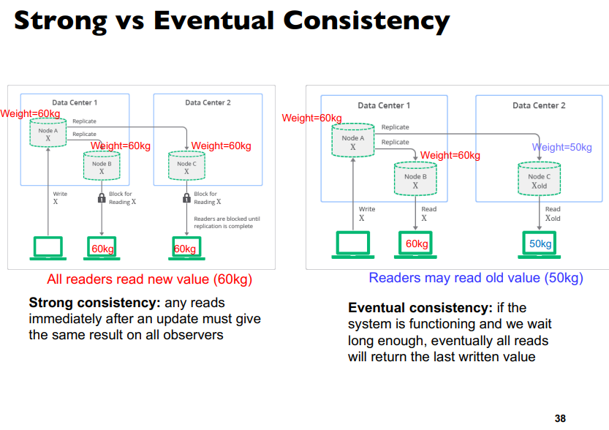
Lecture 4 – Slide 38
NoSQL –
Basically Available
Soft State
Eventually Consist

Slide 5
Solution 1
Pros:
Performance: NoSQL systems often sacrifice strong consistency while aiming for low latency and high availability (e.g., due to removing the need for locks and other concurrency mechanisms)
Scalability: NoSQL systems are straightforwardly horizontally scalable (due to sacrificing strong consistency)
Cons:
Outdated data: outdated data may cause mistakes or require additional work to handle on the application side
Notes:
Reduced Coordination Overhead
Strong consistency typically requires a database to coordinate between multiple nodes to ensure that a write is successfully committed everywhere, or not at all. This coordination often involves complex two-phase commit protocols and can be both time-consuming and resource-intensive. In a system that prioritizes strong consistency, every node must agree on the state of the data before a write is considered successful.
NoSQL databases that opt for eventual consistency, on the other hand, reduce or eliminate this coordination overhead. A write might be considered successful even if it has only been written to a subset of nodes. Other nodes catch up eventually, making it easier to distribute the data across a large number of servers without incurring the penalty of strong consistency.
Faster Writes and Reads
Because they reduce coordination, NoSQL databases that favor eventual consistency can generally perform writes (and often reads) more quickly, especially under high load. This is important for scalability because it allows the system to handle a larger number of operations with the same resources.
Improved Availability and Fault Tolerance
By sacrificing strong consistency, NoSQL databases can often continue to operate even when some nodes are slow or unavailable. This is crucial for horizontal scaling, where you may have a large number of nodes and the likelihood of some of them being unavailable at any given time is high.
Easier Scaling of Nodes
Adding or removing nodes is generally easier when you're not trying to maintain strong consistency. In a system where strong consistency is required, adding a new node often involves redistributing data and then ensuring that the new node is brought up-to-date before it can participate in the cluster—a process that can be both complicated and time-consuming. In contrast, NoSQL databases that favor eventual consistency can often add nodes more seamlessly, quickly integrating them into the system without a lengthy initialization process.
Geographical Distribution
For global applications, data can be replicated across different geographical locations more efficiently when strong consistency is not a strict requirement. This is because eventual consistency allows for some lag between when data is written in one location and when it becomes available in another, which is often acceptable for applications that can tolerate a degree of inconsistency.

Slide 6
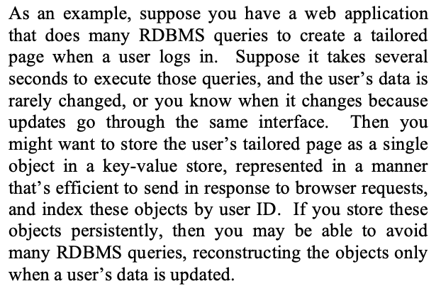
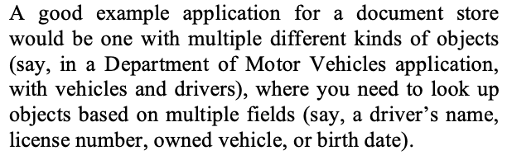
Question 2
In the mentioned paper, they list a suitable application for key-value stores:
And for document stores:
Discuss some factors that make these applications suitable for key-value stores and document stores respectively.
Rick Cattell. 2011. Scalable SQL and NoSQL data stores. SIGMOD Rec. 39, 4 (May 2011), 12-27.

Slide 7
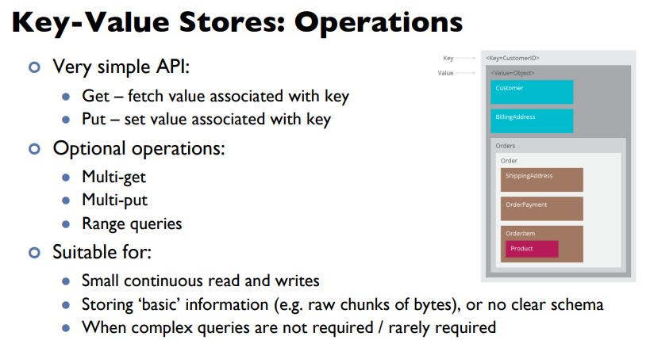
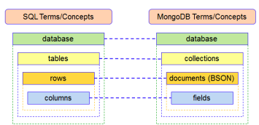

Solution 2
Key-value store:
Improves scalability and efficiency – writing or reading user pages is faster.
No need for complex queries or based on the content of user pages – just reads and writes.
May be acceptable for user pages to be slightly stale – then eventual consistency is acceptable
Document store:
Flexible schema may be beneficial (e.g. special types of vehicles may require different sets of fields)
Unlike key-value stores, document stores are more suitable for queries based on fields of a document
Notes:
Data Model:
MongoDB: Stores data as BSON (Binary JSON) documents, which can contain arrays and nested documents, allowing for complex data hierarchies.
Traditional RDBMS: Stores data in tables with rows and columns. Data is separated into different tables for different entities, and relationships are established using keys.
Schema:
MongoDB: Schema-less, meaning the structure of documents in a collection can differ. This allows for greater flexibility and can be particularly useful for unstructured or semi-structured data.
Traditional RDBMS: Fixed-schema, meaning the structure of tables is defined in advance and changes usually require altering the whole table. This can make them less flexible when managing unstructured data.
Scalability:
MongoDB: Designed for horizontal scalability, making it easier to add or remove nodes in the system.
Traditional RDBMS: Typically optimized for vertical scalability, which means scaling often involves adding more power to a single server.
Transactions:
MongoDB: Supports ACID transactions as of version 4.0 but is generally more relaxed in terms of consistency to allow for better performance and scalability.
Traditional RDBMS: Built with strong ACID compliance for transaction integrity.

Slide 8
Question 3
Assume that your e-commerce company’s webpage has a NoSQL document store database containing data about users visiting the webpage (e.g. IP address, country, time spent browsing the webpage, number of products they have bought, etc.) Your CEO suggests using the Range Partitioning scheme with the number of products they have bought as a partition key. State and explain a possible benefit of this choice, and a possible disadvantage of this choice.

Slide 9
Solution 3 - Example
[
"userID": 1, "IP": "192.168.1.1", "Country": "US", "TimeSpent": 30, "ProductsBought": 5}, {"userID": 2, "IP": "192.168.1.2", "Country": "CA", "TimeSpent": 25, "ProductsBought": 2}, {"userID": 3, "IP": "192.168.1.3", "Country": "UK", "TimeSpent": 15, "ProductsBought": 0}, {"userID": 4, "IP": "192.168.1.4", "Country": "AU", "TimeSpent": 40, "ProductsBought": 10}, {"userID": 5, "IP": "192.168.1.5", "Country": "FR", "TimeSpent": 20, "ProductsBought": 1}, {"userID": 6, "IP": "192.168.1.6", "Country": "DE", "TimeSpent": 50, "ProductsBought": 5}, {"userID": 7, "IP": "192.168.1.7", "Country": "JP", "TimeSpent": 35, "ProductsBought": 7} ]
]
Partition 1: 0-2 products bought: [
{"userID": 2, "IP": "192.168.1.2", "Country": "CA", "TimeSpent": 25, "ProductsBought": 2}, {"userID": 3, "IP": "192.168.1.3", "Country": "UK", "TimeSpent": 15, "ProductsBought": 0}, {"userID": 5, "IP": "192.168.1.5", "Country": "FR", "TimeSpent": 20, "ProductsBought": 1} ]
Partition 2: 3-5 products bought: [
, "userID": 1, "IP": "192.168.1.1", "Country": "US", "TimeSpent": 30, "ProductsBought": 5},
{"userID": 6, "IP": "192.168.1.6", "Country": "DE", "TimeSpent": 50, "ProductsBought": 5},]
Partition 3: More than 5 products bought: [
{"userID": 4, "IP": "192.168.1.4", "Country": "AU", "TimeSpent": 40, "ProductsBought": 10},
{"userID": 7, "IP": "192.168.1.7", "Country": "JP", "TimeSpent": 35, "ProductsBought": 7} ]]

Slide 10
Solution 3
Benefits:
If we need to run filter or group by queries based on the number of products bought (e.g., frequent buyers vs new buyers), this partitioning scheme is efficient (as information about buyers with similar number of products bought is co-located, allowing faster queries without needing to scan the entire database.
Disadvantages:
May lead to highly imbalanced partitions, e.g. if a large number of users have only bought 1 product
Maintenance: when a customer starts buying a lot of products, they need to be moved from one partition to another, leading to additional overhead.
Other queries: other user characteristics may be more important, like age, geography etc. Queries grouping by such characteristics would need to scan multiple partitions.

Slide 11
Question 4
Imagine you are developing a digital platform for NUS students to manage their courses and extracurricular activities they are taking, which also manages information about courses (e.g., professors, prerequisites, time-tables, etc), and aims to recommend courses for students.
Consider the NoSQL databases we have covered in the class, and choose one which is suitable for satisfying a specific use-case within the above digital platform. (You do not have to explain how to implement the entire system – you can choose a single use-case to focus on). Explain why your choice is appropriate.

Slide 12
Solution 4
Document Store: could be useful for storing course information or student information. Document stores like MongoDB provide flexible schema to accommodate different course characteristics (e.g., some courses may have prerequisites / cross-listings, others may not). Similarly, some students may input various profile information, while others may not.
Graph DB: could be useful if certain use-cases crucially involve relationships: e.g. recommending courses to students, recommending study groups for students, managing complex prerequisites / time conflicts between courses to recommend a timetable, etc.

Slide 13
Solution 4 - Example
{
"_id": “CS4225/CS5425",
"name": “Big Data Systems for Data Science",
"professor": “Bryan Hooi",
"prerequisites": ["None"],
"time_table": {
“Thursday": “6.30 – 9.30pm",
"Friday": “6.30 – 9.30pm“}
}
CREATE (alex:Student {name: Alex’})
CREATE (cs5425:Course {name: ‘CS5424’})
CREATE (bryan:Professor {name: Prof Bryan’})
CREATE (bds:Interest {name: ‘Big Data System’})
CREATE (alex)-[:ENROLLED_IN]->(cs5425)
CREATE (cs5425)-[:TAUGHT_BY]->(bryan)
CREATE (alex)-[:INTERESTED_IN]->(bds)
Course:
cs5425
Taught_By
Professor:
bryan
Enrolled_In
Student:
alex
Interested_In
Interest:
bds

